Slide 1

Principles of Economics
Swagat Kishore Mishra
Lecturer, Dept. of Economics
Email: swagat@bits-goa.ac.in / sayswagat@gmail.com
VOIP: 207 PSRN: 485 CHAMBER: A-301/16
Tel. 0832-2580207 (O) 08879506995 (M)

Slide 2
Production Theory and Cost function
Defination
Total Product, Average Product and Marginal Product
Short Run and Long Run
Returns to scale (CRS, IRS and DRS)
NEXT…….
Cost curves
Market forms
Perfect competition

Slide 3
Defination
The production function of a firm is a relationship between inputs used and output produced by the firm.
For various quantities of inputs used, it gives the maximum quantity of output that can be produced.

Slide 4
We may write the production function as
q = f (x₁, x₂)
It says that by using x₁ amount of factor 1 and x₂ amount of factor 2, we can at most produce q amount of the commodity.

Slide 5
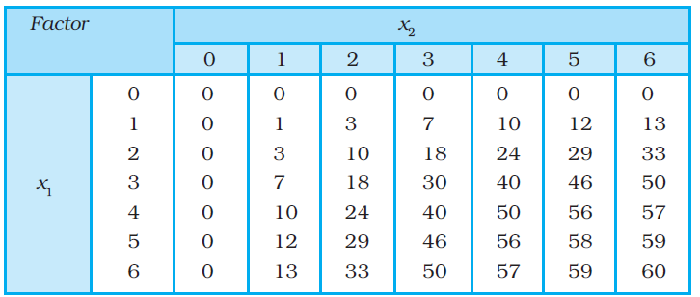
The left column shows the amount of factor 1 and the top row shows the amount of factor 2.
As we move to the right along any row, factor 2 increases and as we move down along any column, factor 1 increases.
For different values of the two factors, the table shows the corresponding output levels.
For example, with 1 unit of factor 1 and 1 unit of factor 2, the firm can produce at most 1 unit of output; with 2 units of factor 1 and 2 units of factor 2, it can produce at most 10 units of output; with 3 units of factor 1 and 2 units of factor 2, it can produce at most 18 units of output and so on.

Slide 6
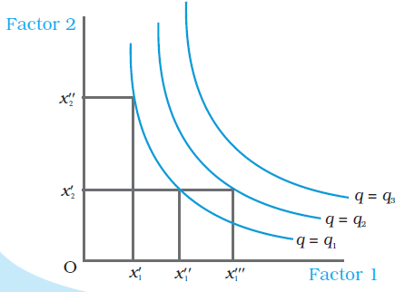
Consider a production function with two inputs factor 1 and factor 2.
An isoquant is the set of all possible combinations of the two inputs that yield the same maximum possible level of output.
Each isoquant represents a particular level of output and is labelled with that amount of output.
In the diagram, we have three isoquants for the three output levels, namely q = q1, q = q2 and q = q3 in the inputs plane. Two input combinations (x′1, x′′ 2) and (x′′ 1, x′2) give us the same level of output q1.
If we fix factor 2 at x′2 and increase factor 1 to x′′′ 1 , output increases and we reach a higher isoquant, q = q2.
When marginal products are positive, with
greater amount of one input, the same level of output can be produced by using lesser amount of the other.
Therefore, isoquants are negatively sloped.

Slide 7
Conditions necessary
Both the inputs are necessary for the production.
If any of the inputs becomes zero, there will be no production.
With both inputs positive, output will be positive.
As we increase the amount of any input, output increases.

Slide 8
SHORT RUN
In the short run, a firm cannot vary all the inputs.
One of the factors – factor 1 or factor 2 – cannot be varied, and therefore, remain fixed in the short run.
In order to vary the output level, the firm can vary only the other factor.
The factor that remains fixed is called the fixed input whereas the other factor which the firm can vary is called the variable input.

Slide 9
LONG RUN
In the long run, all factors of production can be varied.
A firm in order to produce different levels of output in the long run may vary both the inputs simultaneously.
So, in the long run, there is no fixed input.

Slide 10
Total Product (TP)
Suppose we vary a single input and keep all other inputs constant.
Then for different levels of employment of that input, we get different levels of output from the production function.
This relationship between the variable input and output, keeping all other inputs constant, is often referred to as Total Product (TP) of the variable input.

Slide 11
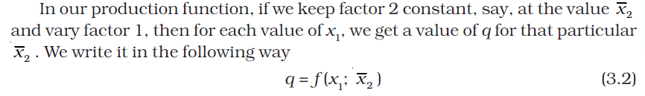

Slide 12

Average Product (AP)
Average product is defined as the output per unit of variable input.
We calculate it as

Slide 13
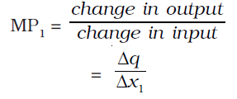

Marginal Product (MP)
Marginal product of an input is defined as the change in output per unit of change in the input when all other inputs are held constant.
When factor 2 is held constant, the marginal product of factor 1 is

Slide 14
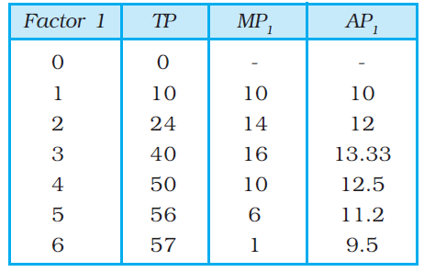
TP, AP and MP

Slide 15
Returns to scale
So far we looked at various aspects of production function when a single input varied and others remained fixed.
Now we shall see what happens when all inputs vary simultaneously.

Slide 16
Constant returns to scale (CRS) is a property of production function that holds when a proportional increase in all inputs results in an increase in output by the same proportion.
Increasing returns to scale (IRS) holds when a proportional increase in all inputs results in an increase in output by more than the proportion.
Decreasing returns to scale (DRS) holds when a proportional increase in all inputs results in an increase in output by less than the proportion.

Slide 17
i.e. suppose in a production process, all inputs get doubled. As a result, if the output gets doubled, the production function exhibits CRS. If output is less than doubled, the DRS holds, and if it is more than doubled, the IRS holds.
Consider a production function
q = f (x₁, x₂)
where the firm produces q amount of output using x₁ amount of factor 1 and x₂ amount of factor 2.
Now suppose the firm decides to increase the employment level of both the factors t (t > 1) times. Mathematically, we can say that the production function exhibits constant returns to scale if we have,
f (tx₁, tx₂) = t.f (x₁, x₂)
i.e. the new output level f (tx₁, tx₂) is exactly t times the previous output level f (x₁, x₂).

Slide 18
Similarly, the production function exhibits increasing returns to scale if,
f (tx₁, tx₂) > t.f (x₁, x₂)
It exhibits decreasing returns to scale if,
f (tx₁, tx₂) < t.f (x₁, x₂)

Slide 19
Next……
Cost curves
Market forms
Perfect competition

Slide 20
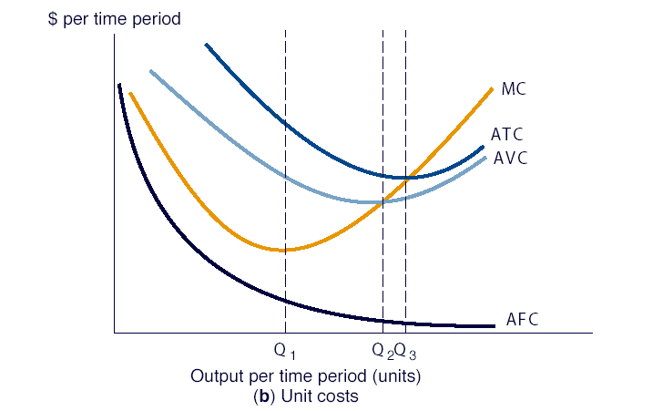

Slide 21
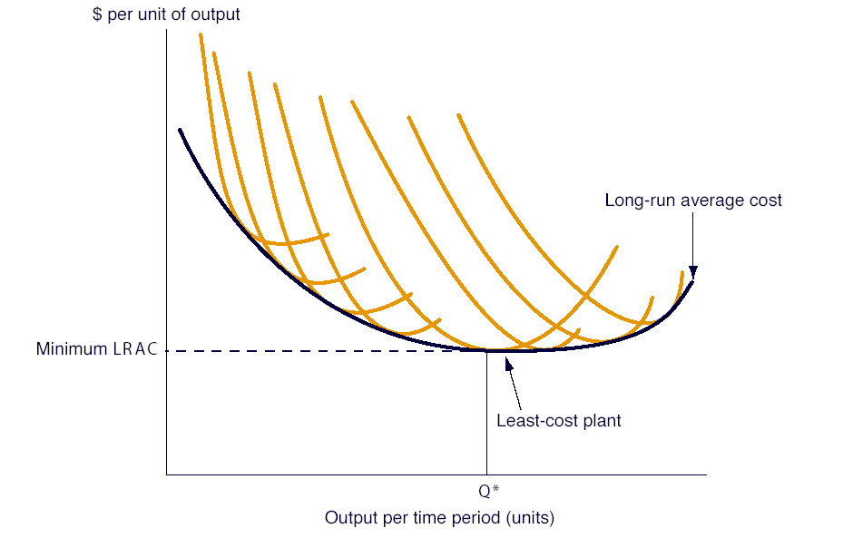
Long-run Average Costs

Slide 22
Forms of Market Competition
Oligopoly
Perfect
Competition
Monopoly
Monopolistic
Competition

Slide 23
Where there are many buyers and sellers, there is competition and this type of market structure is called perfect competition or a Perfectly Competitive Market.
A perfectly competitive firm faces a horizontal demand curve at the going market price.
It is a price-taker. Any other type of firm faces a downward-sloping demand curve for its product and is called an imperfectly competitive firm.
An imperfectly competitive firm cannot sell as much as it wants at the going market price but a perfectly competitive firm can.

Slide 24
A perfectly competitive market is one in which both buyers and sellers believe their own buying or selling decisions have no effect on the market price.
ASSUMPTIONS OF /CHARACTERISTICS OF /CONDITIONS OF PERFECT COMPETITION
A large number relatively small sellers and buyers
Homogeneous product
Perfect knowledge of the market conditions
Free entry to and exit from the market
Perfect mobility of factors of production

Slide 25
Assumption 1
If there are a large number of sellers relative to demand in the market, any one seller will know that, because he supplies so small a quantity of the total output, he can increase or decrease his output without having any significant effect on the market price of the product. The market price is taken as given and any quantity can be sold at that price. The seller is therefore described as a price taker. A firm in the perfectly competitive industry sells such a small proportion of the total market supply that it can double its output or halve it without affecting the market price.

Slide 26
Assumption 2
The products of firms or sellers in a perfectly competitive market must be perfect substitute for that of another and purchase must be solely on the bases of price. This is to ensure that buyers do not care whom they buy from, as long as the price is the same. Without this condition, a producer with a slightly differentiated product can have some degree of control over the market. He may attempt changing output to influence price.

Slide 27
Assumption 3
Both producers and consumers are informed by the current market condition in terms of price, quality of the homogeneous product, supply and so on. This is because there is perfect knowledge in the market and there are many producers of this homogeneous product. The average revenue (AR), marginal revenue (MR) and price (P) would be the same under perfect competition and would coincide with the perfectly elastic demand curve (horizontal demand curve). The reason is simple. Since price is fixed, the additional revenue that will be derived from the sale of an additional unit (marginal revenue) of the output will be equal to the price of the product. AR is the same as P. Therefore under perfect competition MR=P=AR. This can be understood clearly by table below. We can see from the table that MR=P=AR.

Slide 28
Assumption 4
If the number of sellers is to remain large, there must be free entry to the industry, otherwise existing firms could combine to influence price or could grow in size as existing firms leave the industry. Free entry allows the profit motive to function. If demand increases causing price of the product to rise, the possibility of profits will attract other firms into that industry. Likewise, if the demand falls, losses sustained by some firms will cause them to leave the industry.

Slide 29
Assumption 5
A change in demand for a product in the long run must result in factors of production being transferred from one line of production to another. Moreover all factors, including entrepreneurship must be equally available to all firms.

Slide 30
Relationship Between Price (P), Marginal Revenue (MR), Total Revenue (TR) and Average Revenue (AR)
Quantity sold (Q) | Price (P) | Total Revenue (TR) = P.Q | Average Revenue(AR) = TR/Q | MR = dTR/dQ
1 | $1000 | $1000 | $1000
2 | $1000 | $2000 | $1000 | $1000
3 | $1000 | $3000 | $1000 | $1000
4 | $1000 | $4000 | $1000 | $1000
5 | $1000 | $5000 | $1000 | $1000
6 | $1000 | $6000 | $1000 | $1000
7 | $1000 | $7000 | $1000 | $1000
8 | $1000 | $8000 | $1000 | $1000
9 | $1000 | $9000 | $1000 | $1000
10 | $1000 | $10000 | $1000 | $1000

Slide 31
Hence,
A perfectly competitive market is a market in which all market participants are price-takers.
It refers to a complete absence of rivalry among individual firms.

Slide 32
Perfect Competition
Market price = price to the firm = MR (This is the “demand” for the firm’s output & is perfectly elastic.)
P
S
$
MC
P_{e}
P_{e} = MR = d
D
Q
q
Q_{e}
q₁
q*
q₂
The Market
A Firm

Slide 33
Perfect Competition
How can we tell if a firm makes a profit?
Calculate: Total Revenue = P•q* & Total Cost = ATC •q*
Econ Profit = TR - TC
$
MC
ATC
P_{e}
MR = d
q
q*
A Firm

Slide 34

JUBILATION… jashnn manale

Slide 35
Thanking BITS PILANI, K.K.BIRLA GOA CAMPUS
Under the aegis of
Department of Economics
Dr. Mridula Goel (HOD)
Dr. Debashish Pattanaik
Dr. Aswini Kumar Mishra
Dr. Kubendran N.
Dr. Indranil De
Ms. Ambili K.
Mr. Swagat Kishore Mishra

